Slide 1

DBMS PROJECT
ON
BLOOD BANK AND DONOR MANAGEMENT SYSTEM
PRESENTED BY :
SYED OWAIZ UZ ZAMAN | 1GC21CS096

Slide 2
CONTENTS
Introduction
Tools Used
Software Requirements
ER Diagram
Relational Schema
Modules Of Project
Result Of The Project
Security System
Future Scope
Conclusion

Slide 3
Introduction
A BBMS is a comprehensive solution designed to streamline the administrative, inventory, and clinical aspects of blood banks.
Key features of a BBMS include donor registration, blood inventory management, blood requisition and cross-matching, report generation, and a secured environment and login facility.
The BBMS is typically a browser-based solution that uses a Database Management System (DBMS) and programming languages like PHP to store, process, retrieve, and analyze information

Slide 4
Tools Used
FRONTEND SITE
HTML
AJAX
JQUERY
JAVASCRIPT
BACKEND SITE
PHP
DATABASE
MySQL

Slide 5
Software Requirements
XAMPP was installed on the windows 11 machine and APACHE2 Server and MySQL were initialized And files were built inside opt/lampp/htdocs/bbdms.
VS Code was used as a text editor.
Microsoft Edge was used to run the project (localhost/bbdms was used as the url).

Slide 6
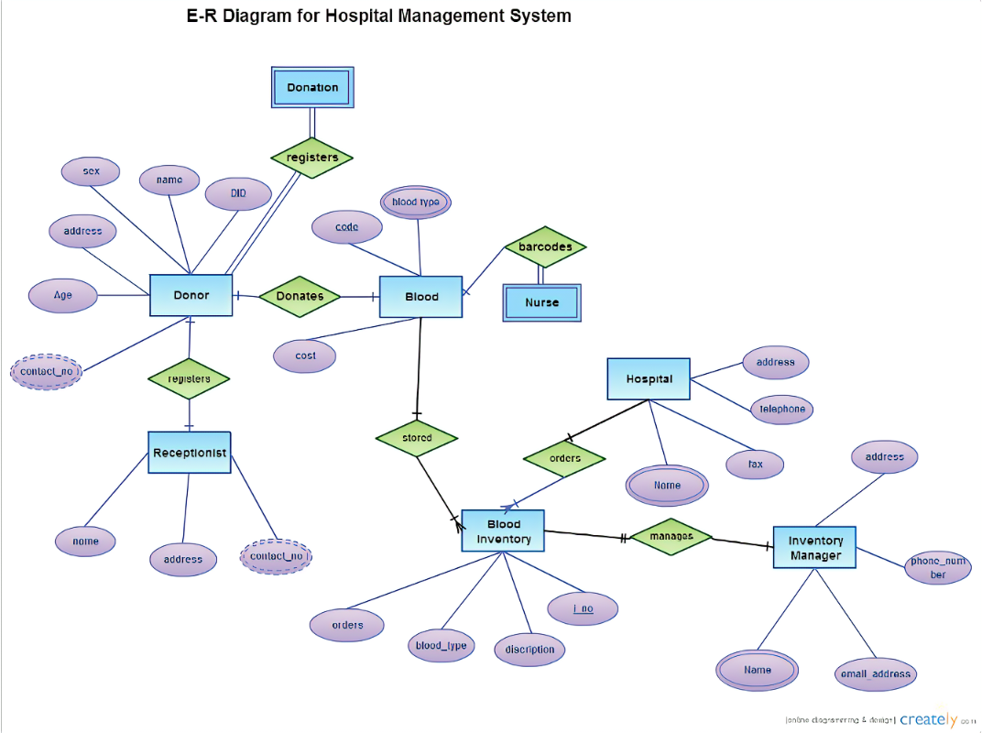
ER Diagram

Slide 7
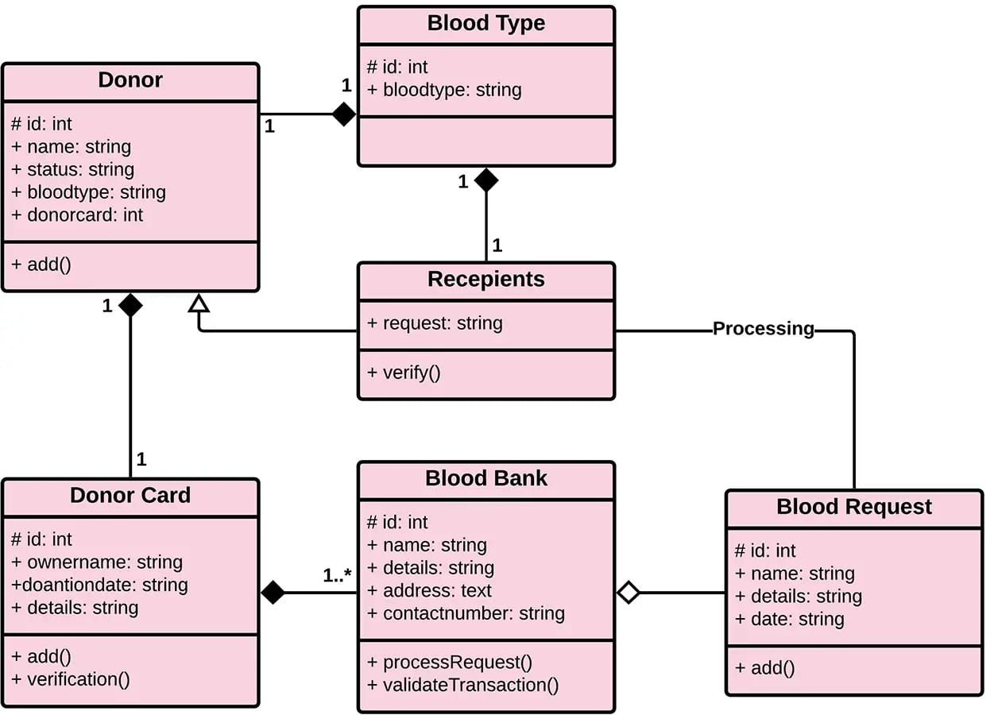
RELATIONAL SCHEMA

Slide 8
Modules Of Project
Blood Bank and Donor Management System contains three modules
Admin Module.
2. Donor Module.
3. Recipient Module.

Slide 9
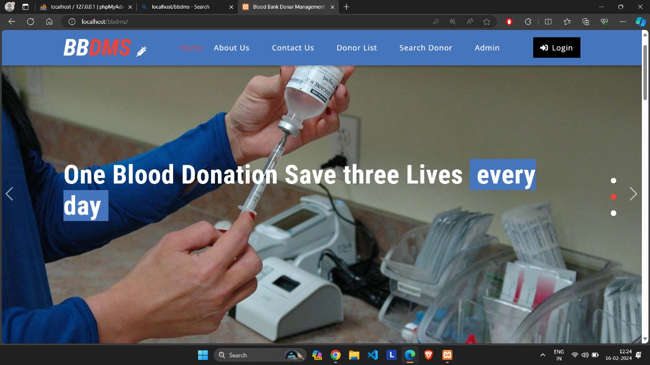
Result Of The Project

Slide 10
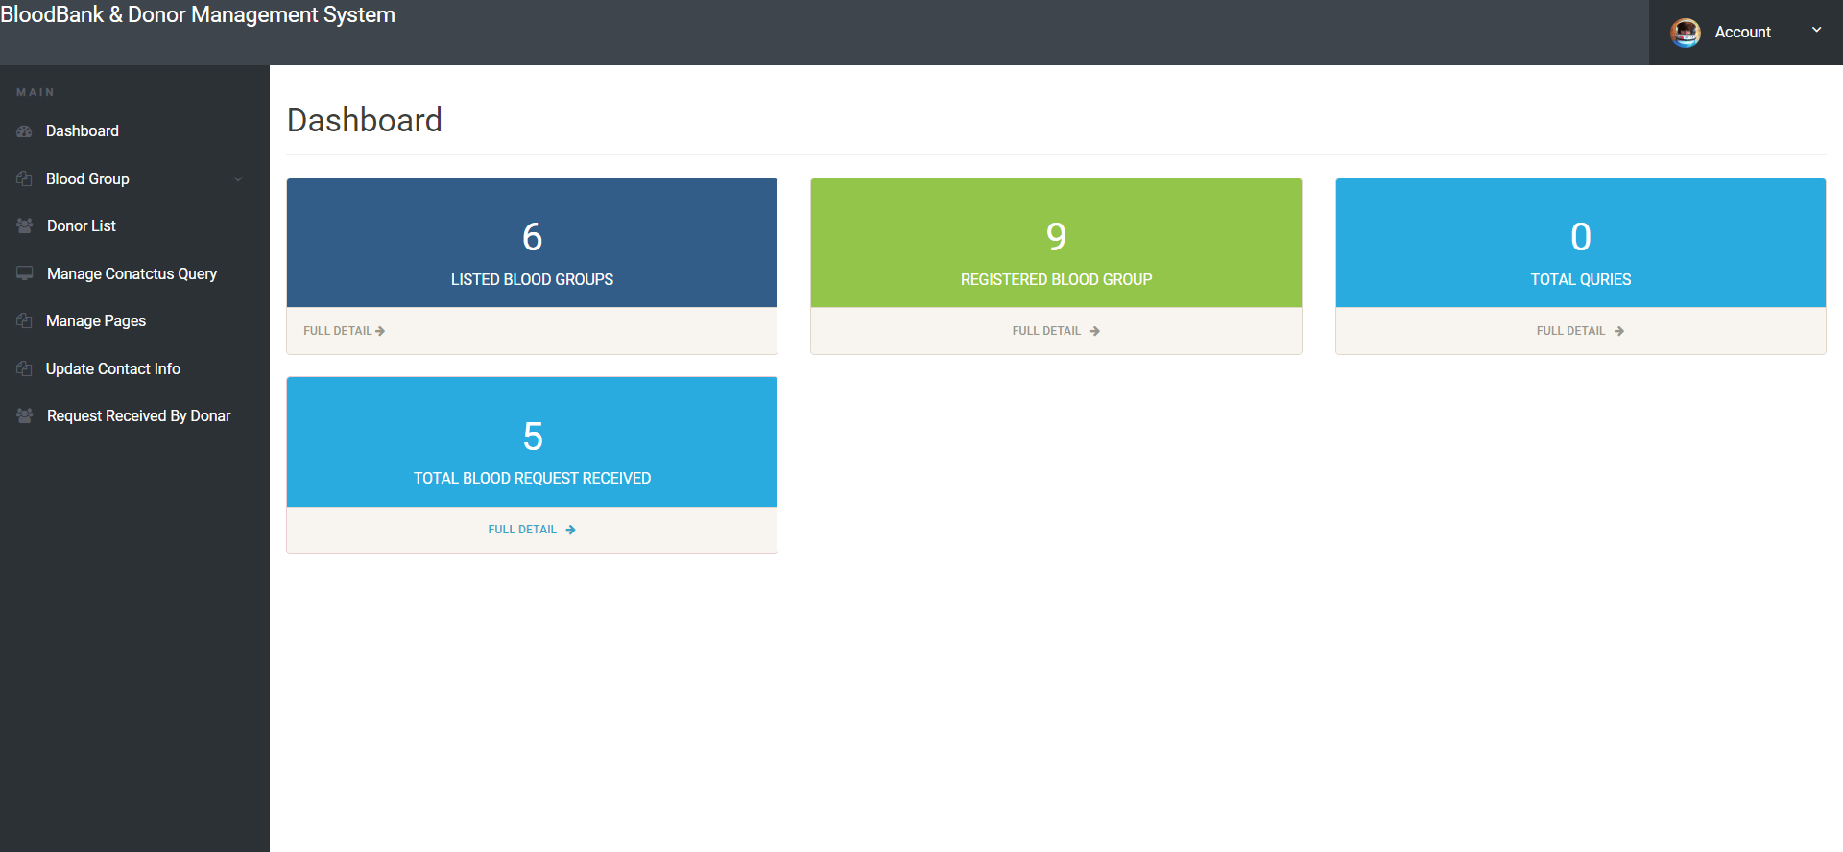
Admin dashboard

Slide 11
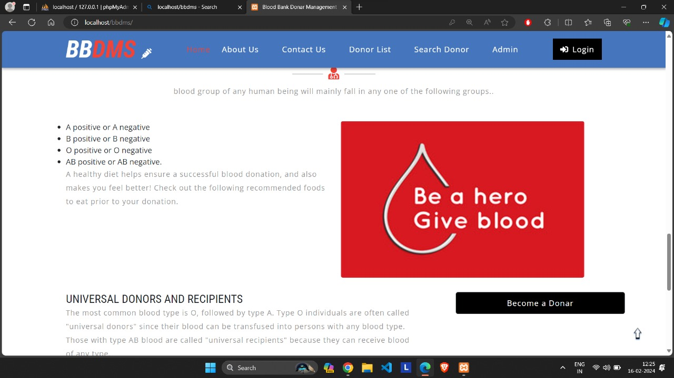
Blood groups available

Slide 12
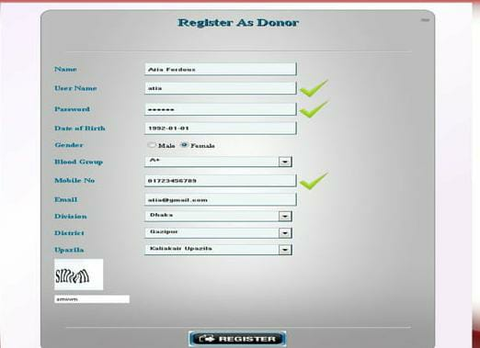
Registration site

Slide 13
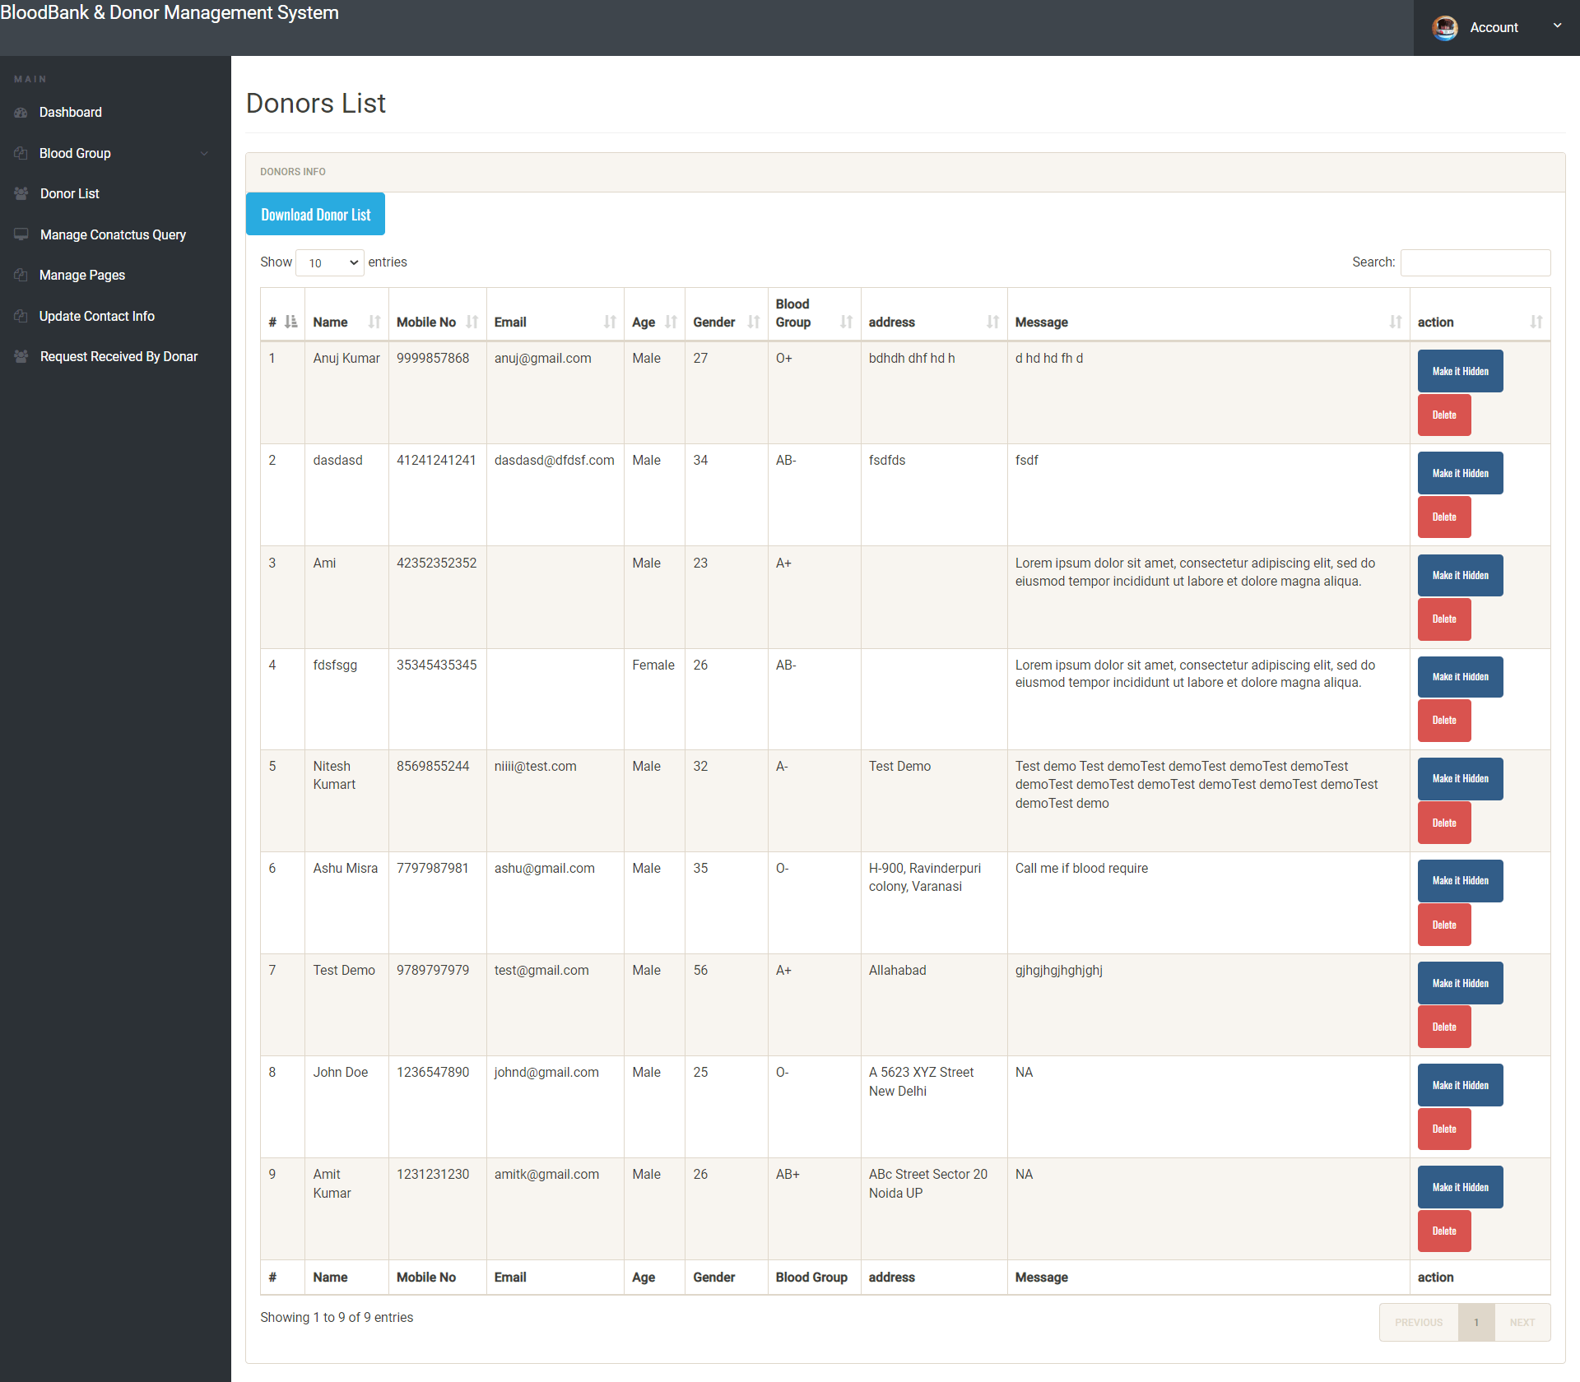
Donors dashboard

Slide 14
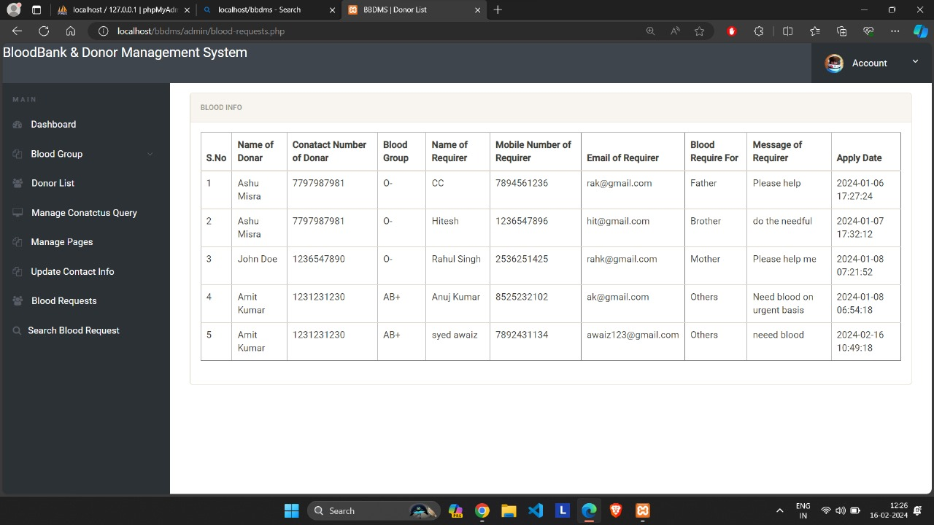
Blood requirer site

Slide 15
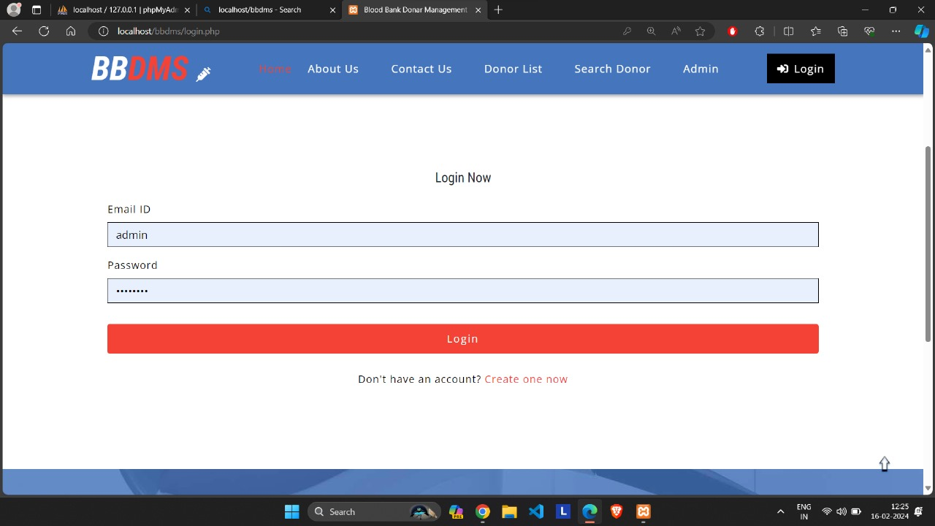
Login dashboard

Slide 16

Footer section

Slide 17
Security System
Administrator can do any kind of insert, update and delete related operation.
Donors can only operate his/her own account.
Acceptor has no permission to do any kind of operation.
Secure form destroy data and any kind of illegal operation.
No one can put information by using any software to fill up our registration Sector.

Slide 18
Future Scope
System can be expanded with availability over worldwide.
Reaching as close as possible of the donor from emergency zone.
A smart phone application of the system can be made.
Providing Donors an option of change his/her availability.

Slide 19
Conclusion
The system enhances blood transfusion safety by providing better ways of handling various processes in blood banks, such as maintaining records, managing inventory, and facilitating communication between blood banks and hospitals.
The system can be expanded to include features like emergency SMS for donors, embedding with hospitals for easier access to blood for patients, and allowing online donor registration.

Slide 20


